Slide 1
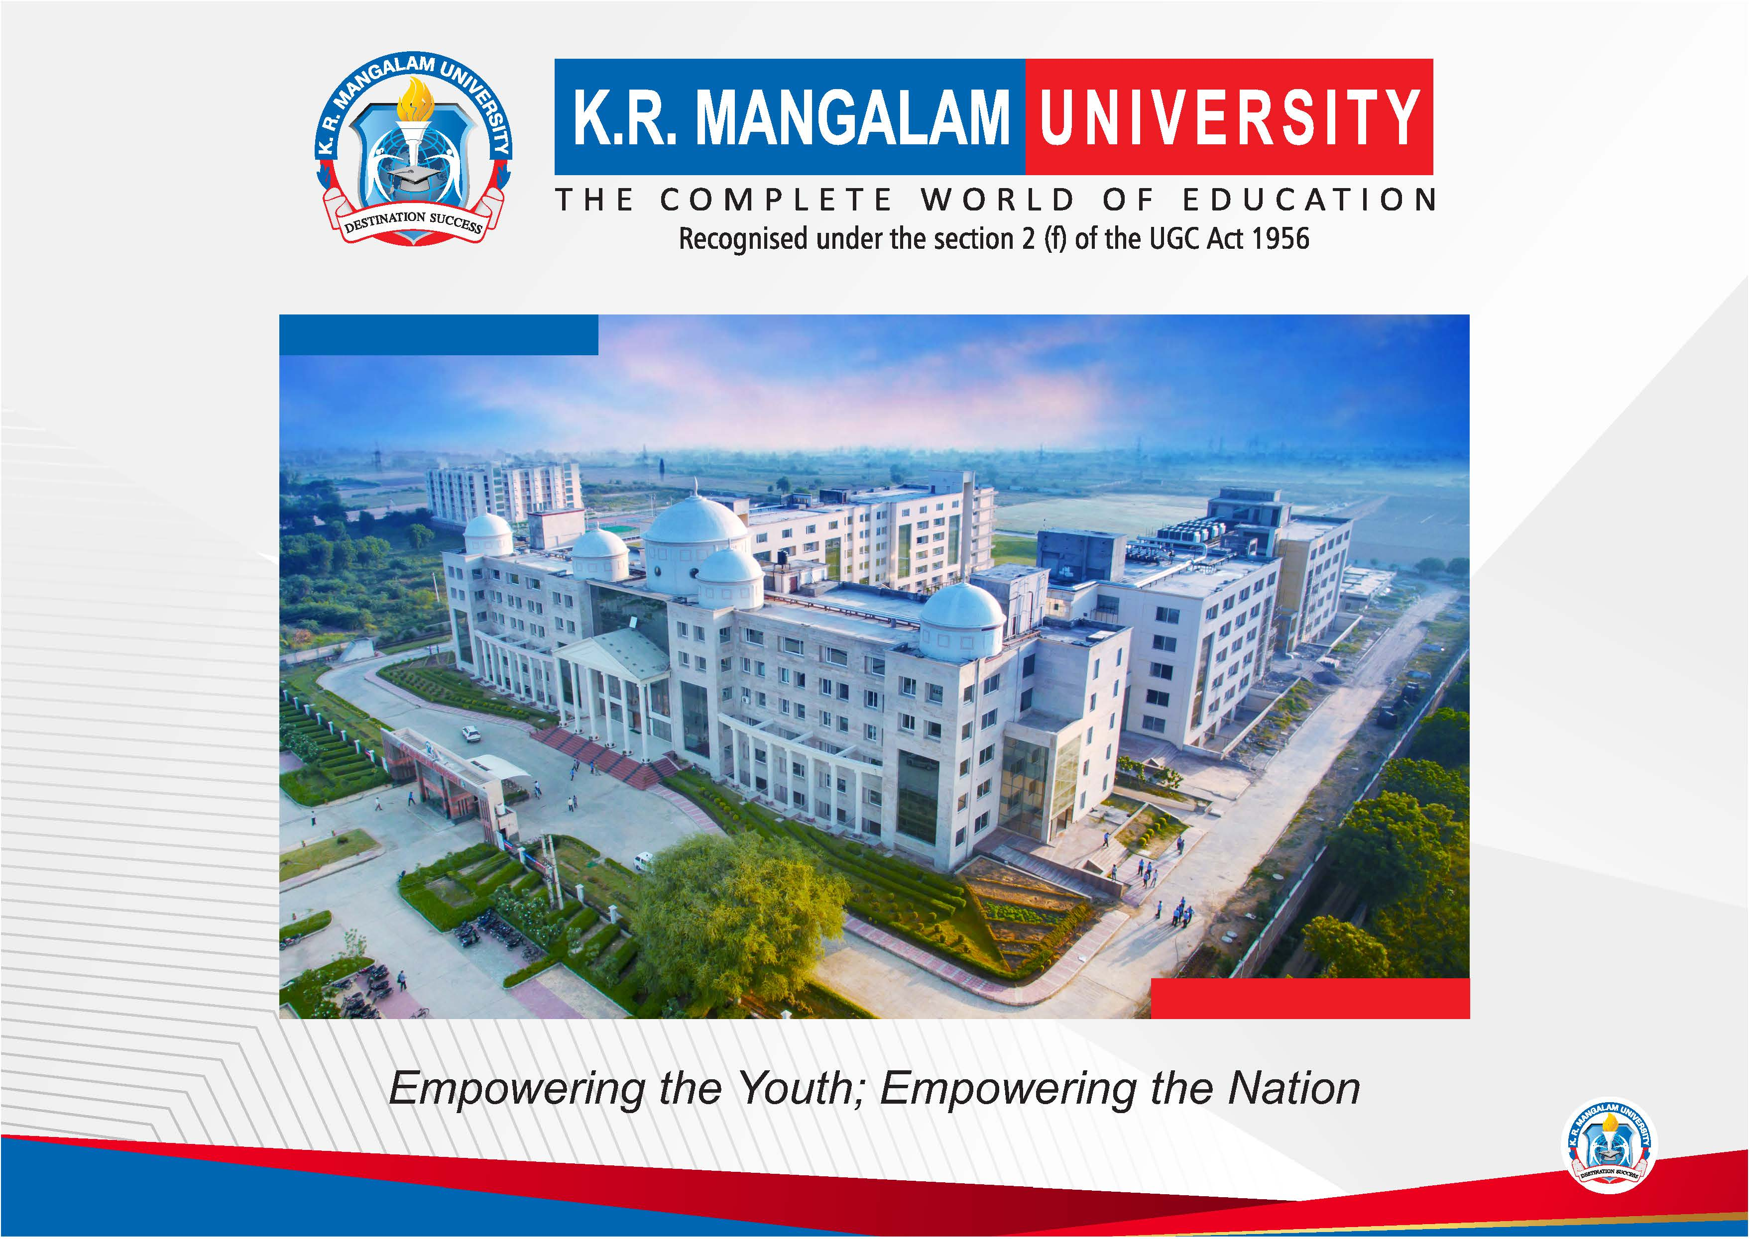

Slide 2


University Fleet Optimization System
Pre-Final Year Project Synopsis
Submitted by
ROLL | NAME
2401830002 | Naman Katewa
2401840003 | Sneha Yadav
2401840006 | Akshaya Tanwar
2401840008 | Nikita Saharan
2401720014 | Kartikeya Drall
Faculty Mentor: Ms. Rishika Mehta
Notes:
New Courses replaced with New Programmes

Slide 3

Project Overview
The Problem:
Managing university transportation across a massive catchment area(Sohna, Gurugram, Faridabad, Palwal, Noida, Bhiwadi) is manually intensive.
Current fixed routes lead to inefficiencies, high fuel costs, and uneven student loads.
The Solution:
A "Zero-Operational Cost" fleet management system built entirely on open-source technologies.
Replaces expensive commercial APIs (Google Maps) with self-hosted routing engines.
The Goal:
To automate route planning using advanced Multi-Depot Capacitated Vehicle Routing Problem with Time Windows (MD-CVRPTW). Our goal is to minimize total fleet mileage while strictly enforcing bus capacities and campus arrival deadlines.
Notes:
New Courses replaced with New Programmes

Slide 4
Specific Objectives
Zero-Cost Architecture:
To achieve professional routing capabilities using self-hosted OSRM and OpenStreetMap data, eliminating recurring API fees.
Regional Optimization:
To effectively model the specific road networks of Haryana and Uttar Pradesh (Extended NCR) for accurate travel time predictions.
Algorithmic Efficiency:
To implement the Vehicle Routing Problem (VRP) using Google OR-Tools to mathematically minimize total fleet mileage.
Constraint Enforcement:
To strictly enforce service rules: Maximum 2-hour ride time and Bus Capacity limits (e.g., 50 seats).
Split-Delivery Logic:
To dynamically split high-demand stops across multiple buses to achieve 100% student coverage without exceeding individual vehicle capacities.
Notes:
New Courses replaced with New Programmes

Slide 5
Key Features
No Recurring Costs:
Runs entirely on local university infrastructure or free-tier cloud services.
Physics Aware Routing:
Custom OSRM Lua profile calibrated for “Bus” physics-enforcing strict 40-second U-turn penalties and capping speeds to realistic urban traffic limits.
Strategic Comparison Mode:
Allows admins to toggle between "Strict" plans (visit every stop) and "Suggested" plans (merge stops for efficiency).
High-Performance Dashboard:
A Next.js-based admin panel utilizing PMTiles and Leaflet to visualize thousands of route coordinates seamlessly without browser lag.
Notes:
New Courses replaced with New Programmes

Slide 6
Progress Summary
System Architecture (Completed):
Successfully decoupled Next.js frontend and FastAPI backend, communicating securely via REST.
Routing Engine (Live):
Open Source Routing Machine (OSRM) fully self-hosted via docker with custom Extended NCR map data.
Algorithmic Optimization (Validated):
Successfully modeled the MD-CVRPTW, processing datasets of 3000+ students and 100+ buses in minutes.
DevOps & CI/CD (Deployed):
Automated deployment pipeline established using Github Actions, Docker, and Nginx reverse proxies.
Notes:
New Courses replaced with New Programmes

Slide 7
Detailed Progress – Development Phase
Phase 1 – Data & Physics:
Engineered a custom Lua profile for OSRM to ensure mathematically generated routes are actually drivable by heavy 12-meter vehicles.
Phase 2 – Algorithmic Tuning:
Conducted exhaustive benchmarking of 30+ Or-Tools configurations. Identified that basic “Savings” heuristics got stuck in local minima, leading to massive inefficiencies.
Phase 3 – The Breakthrough:
Discovered the optimal mathematical configuration: pairing the “Christofides” graph theory heuristic with a “Simulated Annealing” metaheuristic, reducing required fleet size significantly.
Phase 4 – Production Security:
Overcame strict browser CORS policies and Next.js caching errors by engineering a reverse-proxy tunnel using DuckDNS and Let’s Encrypt SSL certificates.
Notes:
New Courses replaced with New Programmes

Slide 8
Methodology
Phase 1: Digitization: Converting Stops addresses into precise GPS coordinates.
Phase 2: Matrix Generation: Using self-hosted OSRM to calculate a massive "Cost Matrix" (Time/Distance) connecting all stops, depots and the campus.
Phase 3: Optimization: Applying the “Christofides" heuristic for initial route generation, followed by “Simulated Annealing” local search to mathematically pack buses and minimizing distance.
Phase 4: Visualization: Rendering the final paths on the admin dashboard using edge-stored PMTiles.
Technologies Used:
Docker: For hosting the routing engine.
PostgreSQL: For structured data storage.
Next.js: For frontend
FastAPI: For backend
Notes:
New Courses replaced with New Programmes

Slide 9
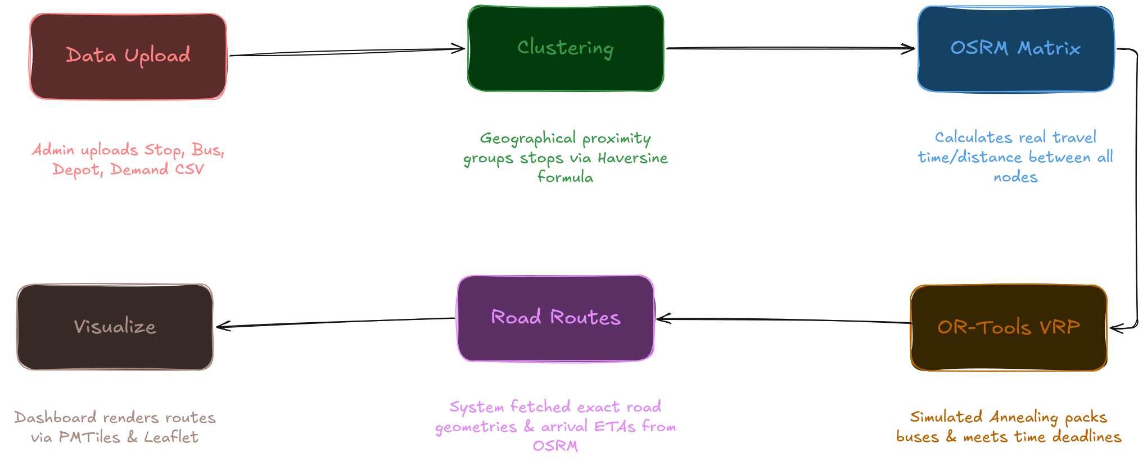
Project Flow diagram
Notes:
New Courses replaced with New Programmes

Slide 10
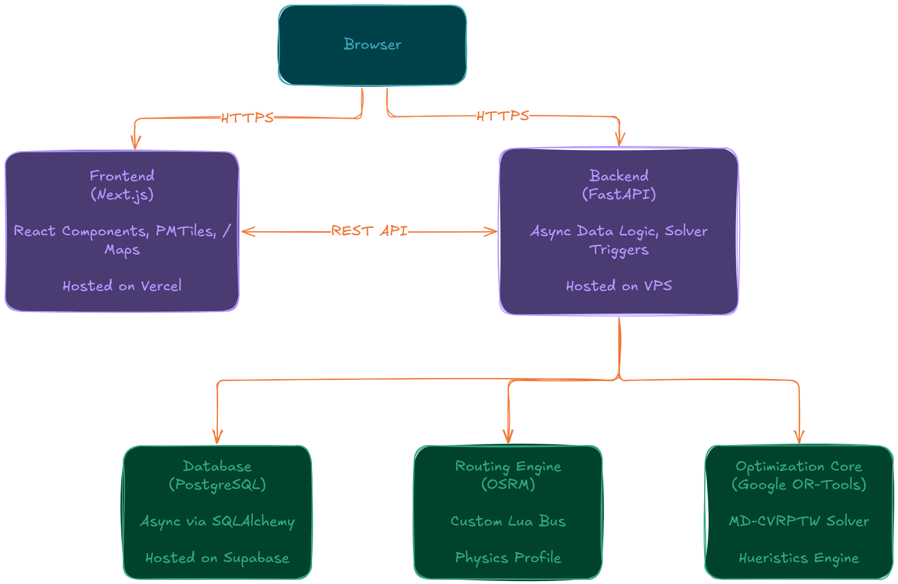
Technical Architecture
Notes:
New Courses replaced with New Programmes

Slide 11
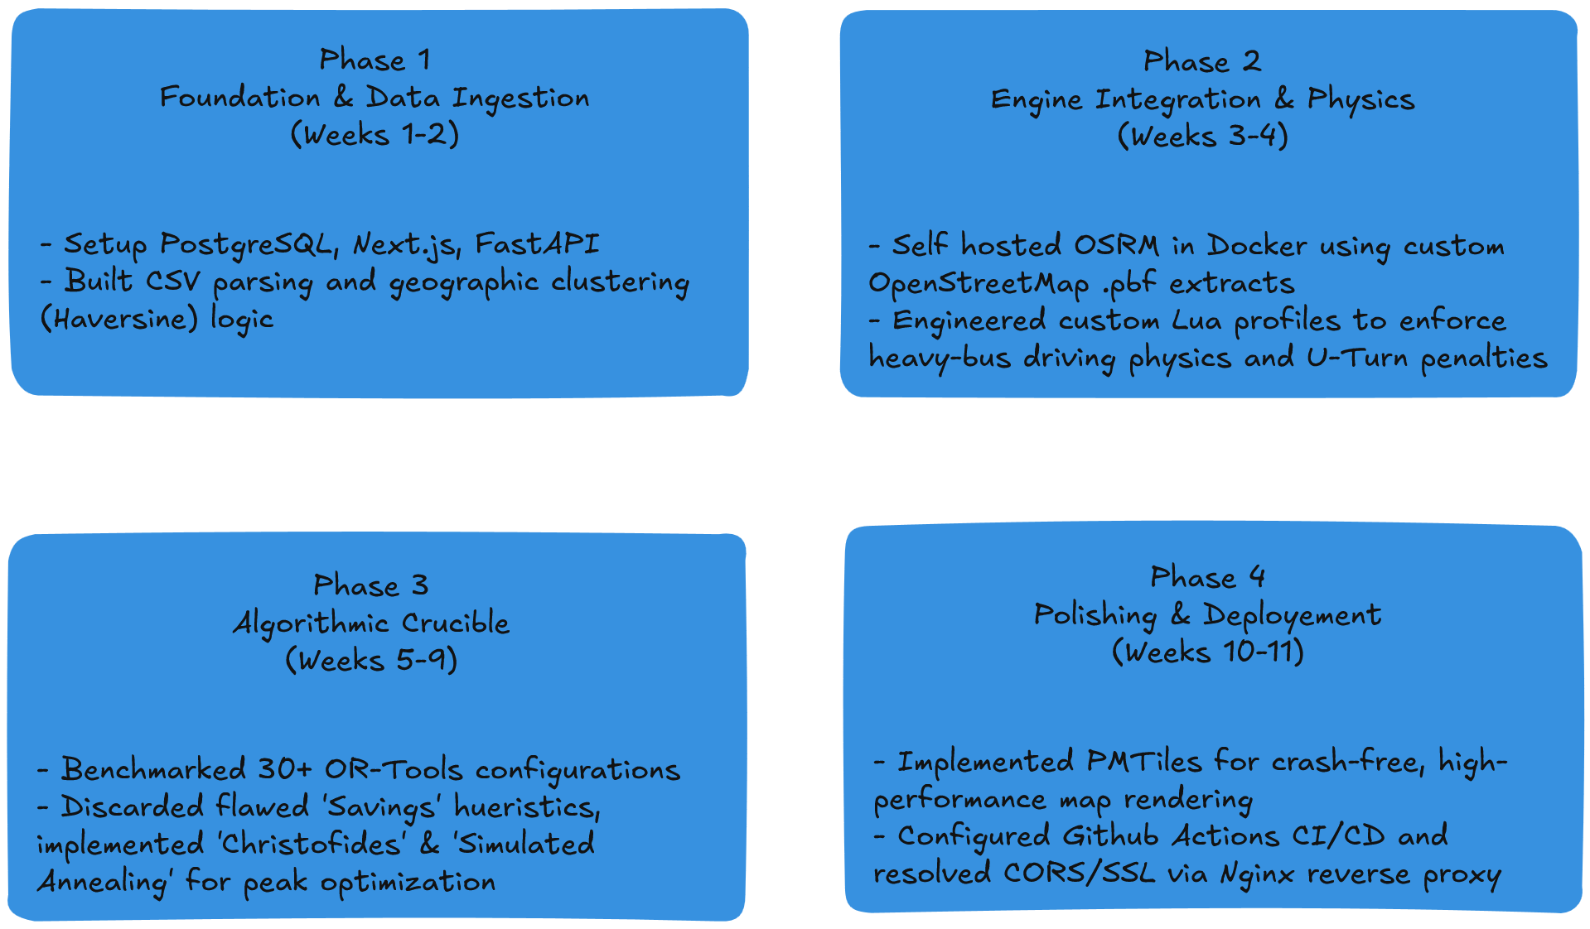
Project Timeline
Notes:
New Courses replaced with New Programmes

Slide 12
Data & Resources
Data Sources
Map Data: OpenStreetMap (OSM) extracts for North India (via Geofabrik).
Stop Data: Geotagged coordinates for student pickup points across Palwal, Faridabad, Noida, etc.
Software & Frameworks
Frontend: Next.js (React), Leaflet.js, TanStack Query, PMTiles.
Backend: Python, FastAPI, Pandas, SQLAlchemy.
Optimization: Google OR-Tools, OSRM (Open Source Routing Machine) with custom Lua profiles.
DevOps & Infrastructure: Docker, Github Actions, Nginx Reverse Proxy, PostgreSQL.
Notes:
New Courses replaced with New Programmes

Slide 13
Project Usecases & Scope
Primary Use cases:
Semester Planning:
Generating the master route schedule at the start of every academic session.
Budget Optimization:
Estimating and reducing fuel budgets by optimizing route kilometers.
Feasibility Testing:
Checking if new routes to distant towns (e.g., Rewari) are viable within time limits.
Scope:
Geographic:
Covers the entire K.R. Mangalam University catchment area (Sohna, Gurugram, Faridabad, Noida, Palwal, Bhiwadi).
Operational:
Focuses on static planning and fleet scheduling (Does not include real-time GPS tracking hardware).
Notes:
New Courses replaced with New Programmes

Slide 14
Expected Results & Impact
Operational Savings:
100% elimination of software licensing costs.
Estimated 10-15% reduction in fuel consumption due to optimized paths while maintaining 100% coverage.
Efficiency:
Reduction in manual planning time from weeks to minutes.
Balanced passenger loads via dynamic split-delivery logic, preventing overcrowding on popular routes.
Sustainability:
Reduction in carbon footprint by minimizing deadhead (empty) kilometers and eliminating unnecessary U-turns and backtracking.
Notes:
New Courses replaced with New Programmes

Slide 15
THANK YOU

